Slide 1
SC1015 Online Shopping Analysis
Minh Quan Nguyen (U2320069H)
Wong Jacqin (U2321852H)
Dana Yak (U2321776D)
Notes:
Good afternoon everyone. Today, we will be presenting our exploration into the realm of ecommerce, making use of a dataset that includes details on each user event, product attributes, and details on user interactions.

Slide 2
Table of contents
01
02
03
04
Motivation
Exploratory Data Analysis (EDA)
Classification Models
Conclusion & Outcomes
Notes:
This is our table of contents.

Slide 3
01
Motivation
Notes:
Firstly, our motivation.

Slide 4
Our Motivation
Problem Definition : What are some factors that affects whether a user buys a product when online shopping ?
We made use of a dataset that includes details on each user event, product attributes, and details on user interactions
Due to the ever-growing e-commerce landscape, where understanding consumer behavior is key for businesses to optimize their strategies
Gather insights by comparing cart VS purchase events
Hence , we
Why this problem ?
Notes:
Our objective? To find out what are some factors that influence and can be used to predict online purchasing behaviour. Our problem statement would thus be this: What are some factors that affects whether a user buys a product when online shopping ?
So, why this problem? The motivation behind this is due to the ever-growing e-commerce landscape, where understanding consumer behaviour is key for businesses to optimise their strategies. As such, we aimed to gather insights that can help businesses tailor their offerings, enhance user experience, and drive conversion rates. To do so, we compare cart VS purchase events.

Slide 5
02
Exploratory Data Analysis
Notes:
Now, let's move onto exploring and analysing our data.

Slide 6
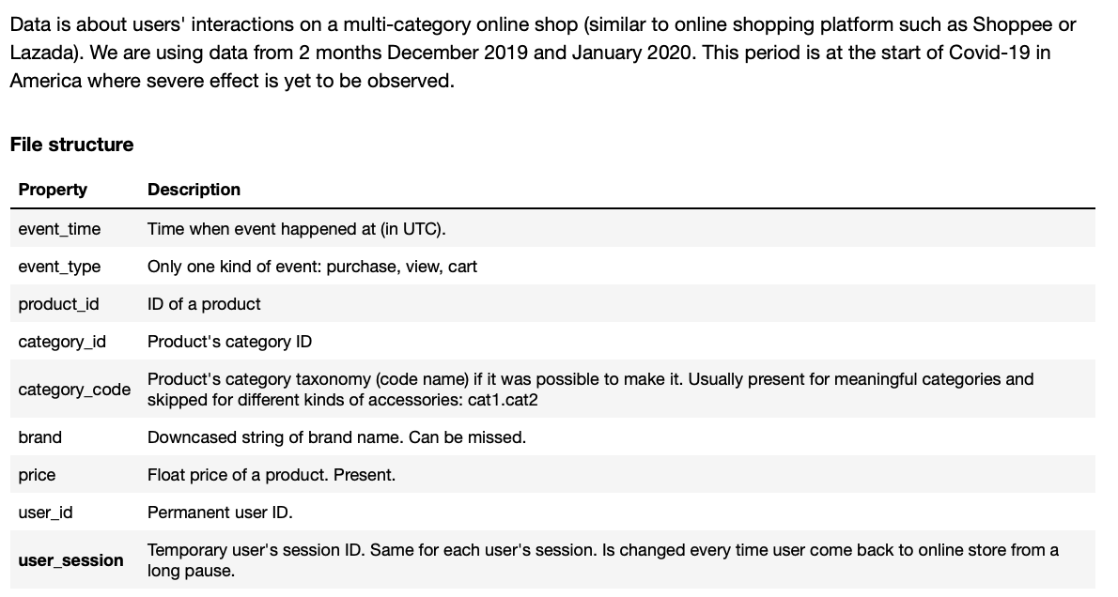
Data Information: Datatypes
Notes:
To achieve our objective, we implemented a multi-step methodology. This involves data preprocessing, feature selection, model training, and evaluation.
Here are the datatypes the dataset had:

Slide 7
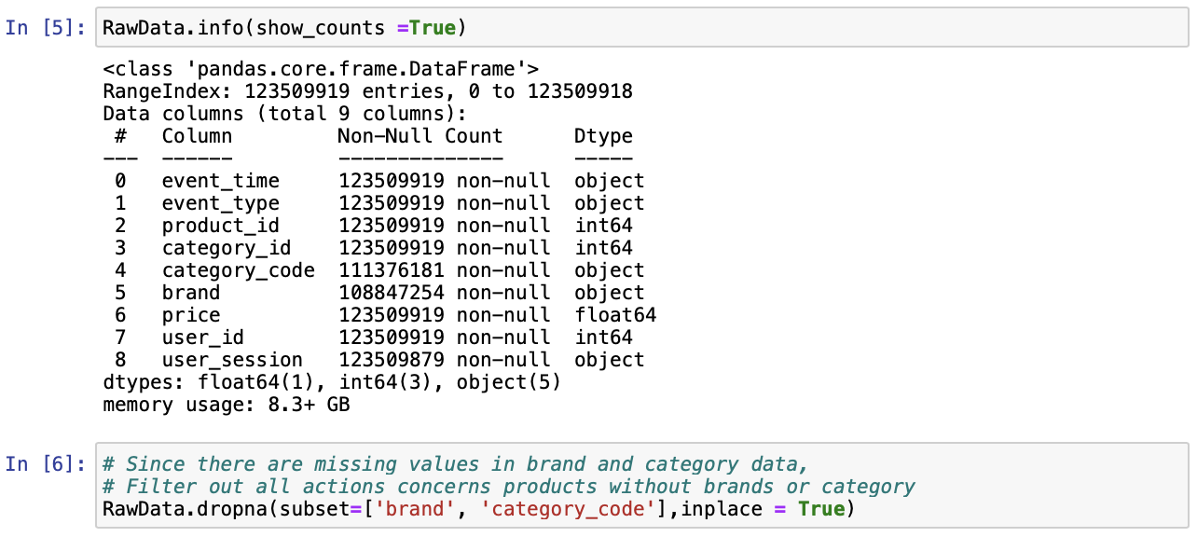
Data Information: Cleaning
Notes:
We began by cleaning the dataset to ensure data quality by handling missing values, outliers, and categorical variables.

Slide 8
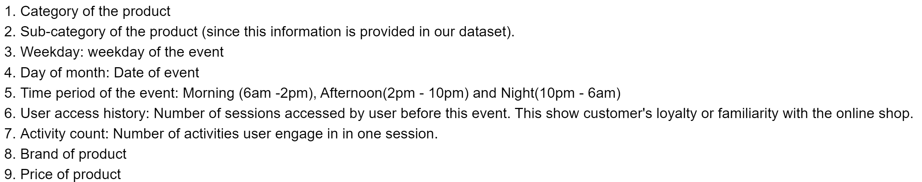
Cleaning our data :
Collapsed data to track a user final action on a product
Filtering out unnecessary data
Added new variables
To identify what variables to add and what to remove, we first have to determine the key predictors
This was determined based off logical deductions
Notes:
During cleaning, we filtered out unnecessary data and added new variables that that we will talk about again later.

Slide 9
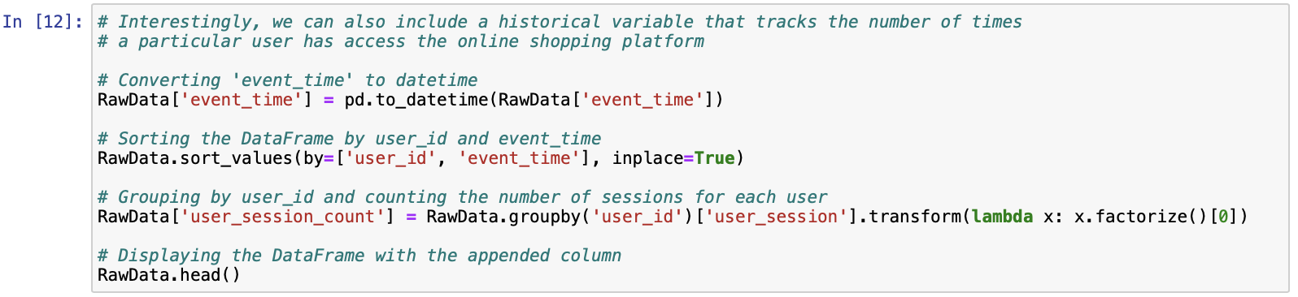
Data Information: Grouping
Notes:
To retain vital relationships, we then grouped all information for the same user_session together under a new variable called activity_count, converted event_time to date and grouped userID with the number of sessions they each have under user_session_count.

Slide 10
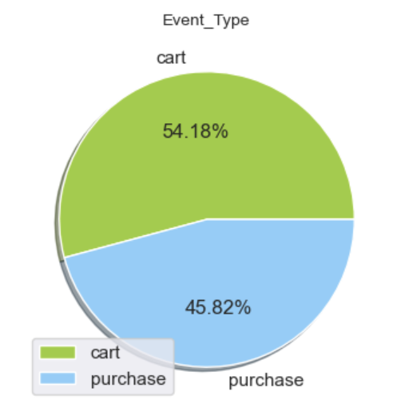
Data Information: Preliminary Analysis
Notes:
Before we start, we did a preliminary analysis and found that only 45.82% of carted items become a purchase, and we would like to find out more about what are the key predictors that affect whether a cart item will become a purchase

Slide 11
Variables Considered
Product / Sub
Categories
Time Period
Day of Week / Month
Timing during the day that users add to cart or purchased
How interactions with webpage change with the months
Different categories users have bought
Sessions Activities and User History
Price
Brand
Price of products purchased
Brands of Product
How often a user visits the site and their interactions with the site
Notes:
Next, we identified relevant features and came up with some key predictors that could potentially impact our problem analysis.
Instead of doing a one-vs-rest multi-class model, we opted for a 2 step approach which only needs 2 models. Due to time constraints, we focused on predicting whether a cart item will be purchased and thus split the dataframe into cart data events & purchase data events for easier visualisation.

Slide 12
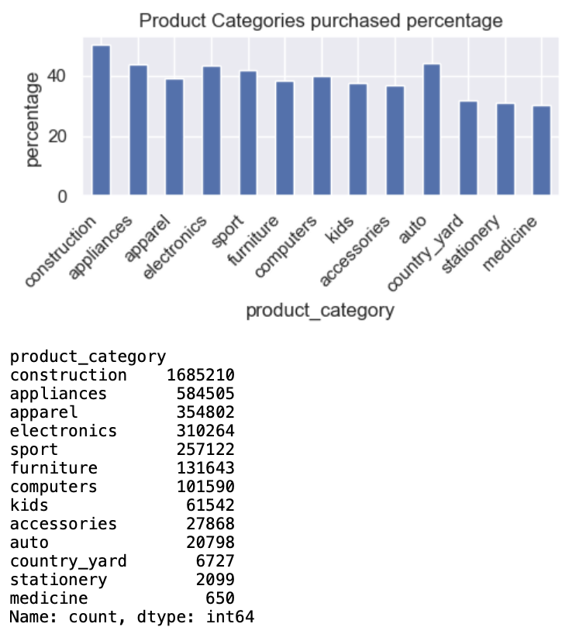
Product Categories and Sub Categories
no significant difference
in the cart to purchase ratio for each product category
55-45 split
especially among the top product categories
70-30 split in the last 3 product category , however this error
is attributed to the lower sample size
May not be a good predictor of a purchase of items in cart
as it is equally likely for a product from any category in the cart to be purchased as they are to be left in cart.

Slide 13
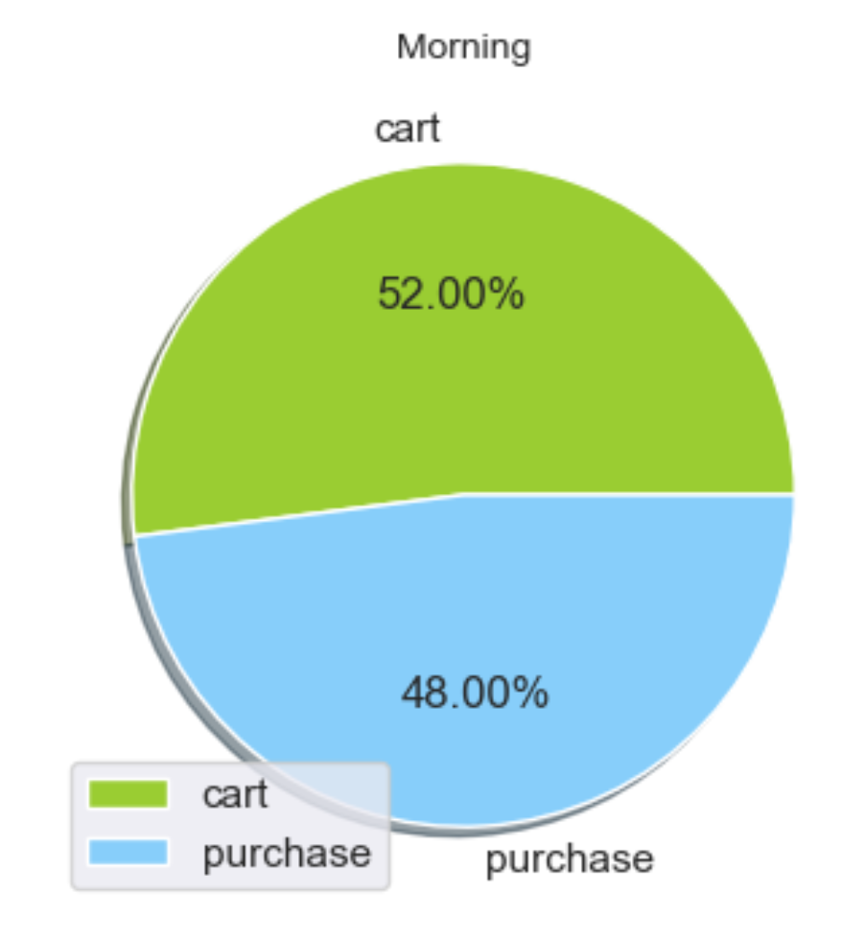
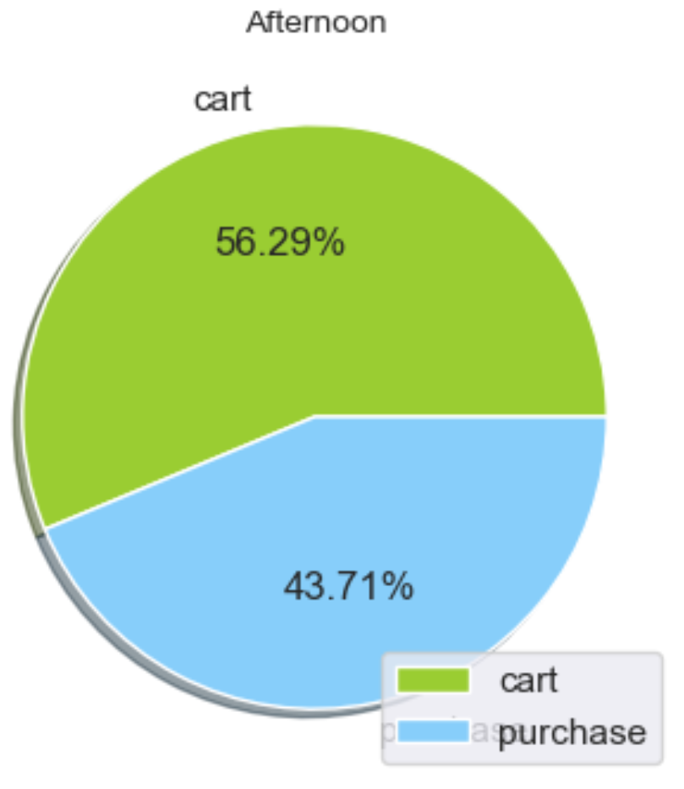
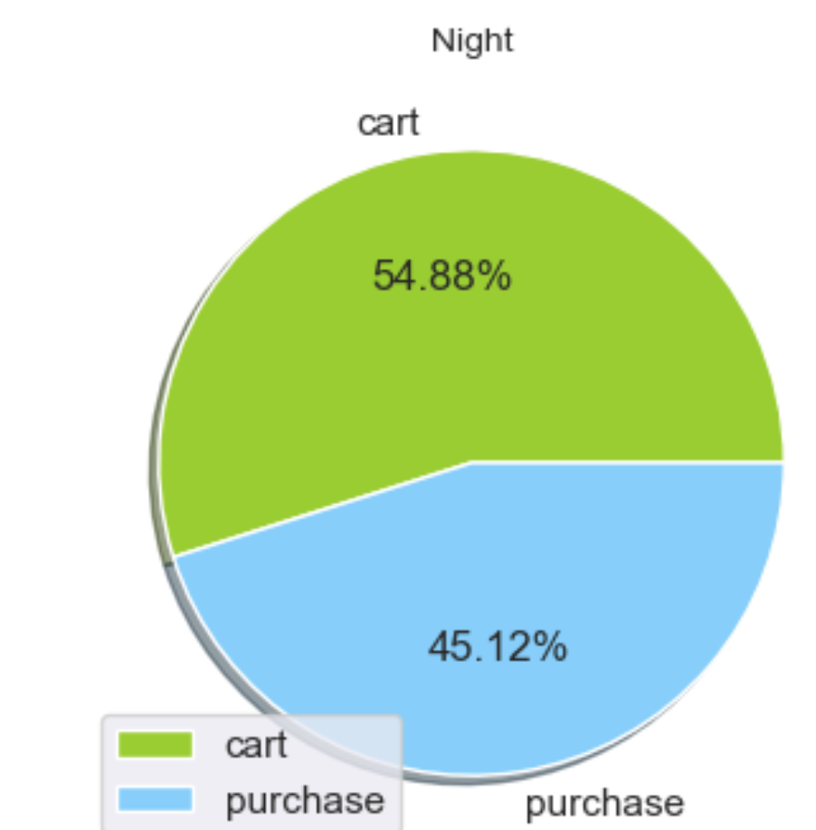
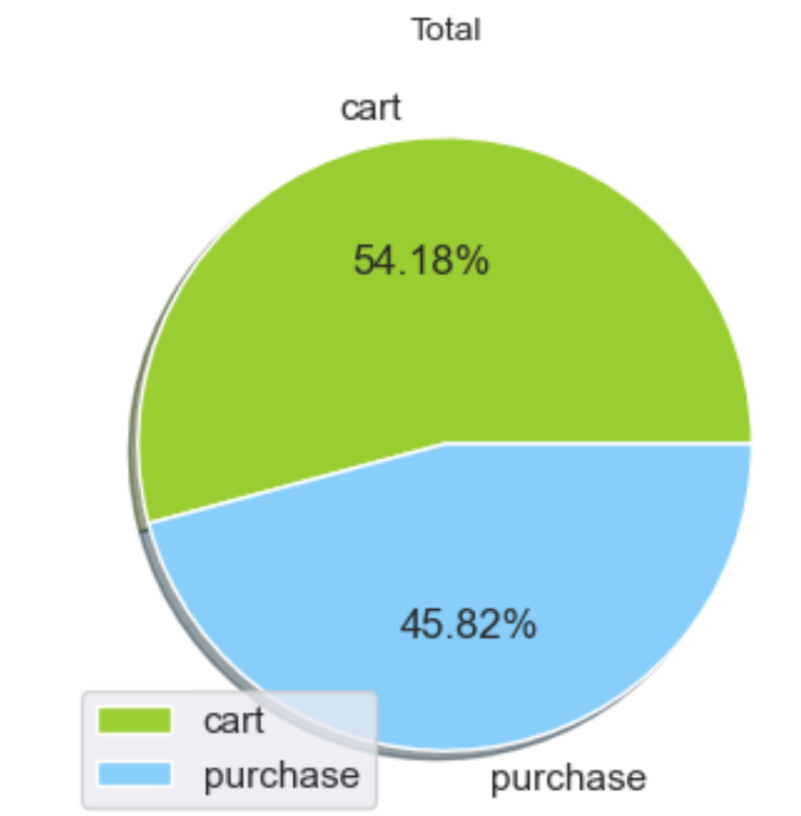
Time Period
Hard to use time period as a predictor of whether an item was purchased or not
Differences in distribution of different time periods ( morning , noon , night ) as compared to the overall distribution is very small , with at most a 2.2% difference. And thus can even be considered as negligible

Slide 14
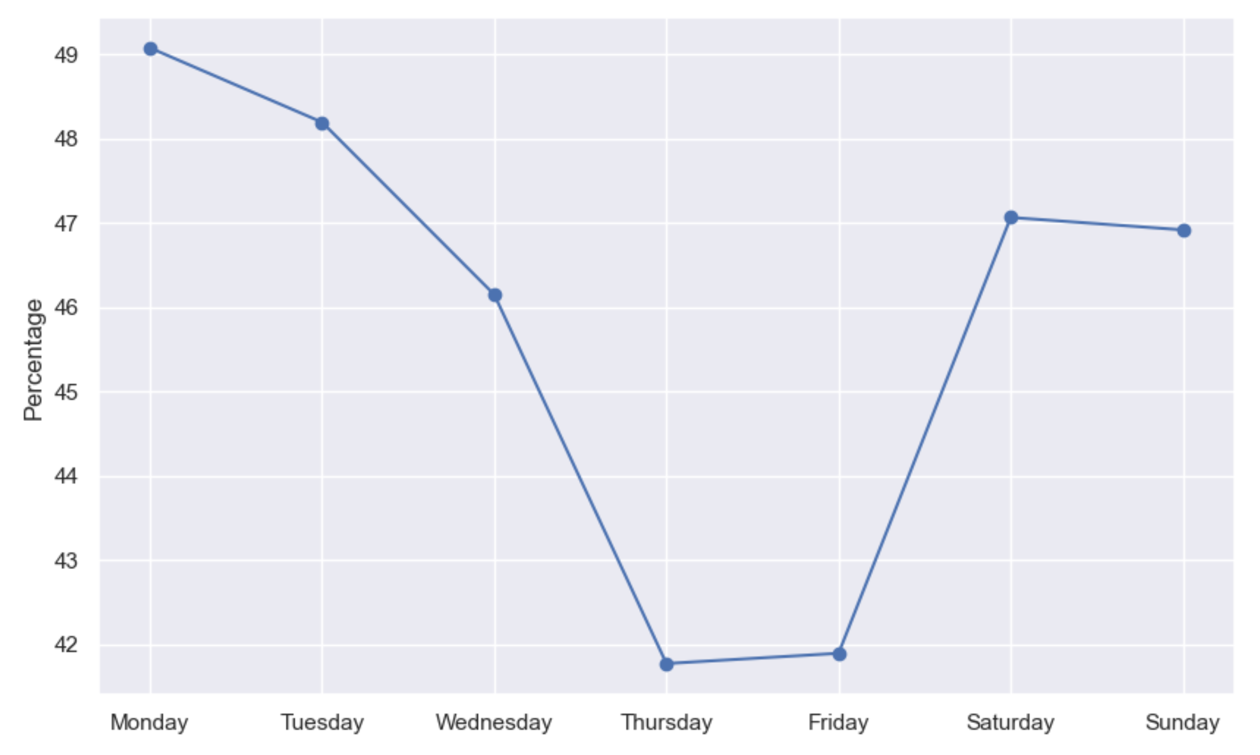
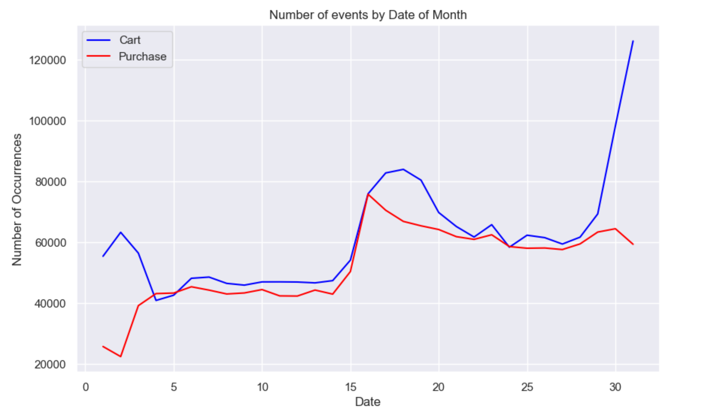
Significant difference in cart and purchase data from beginning to end of month ( among carted items )
Good Predictors
Day of Week
Time of Month
Monday and Sundays have highest cart items who get purchased while Thursday and Fridays have lowest ( huge difference )

Slide 15
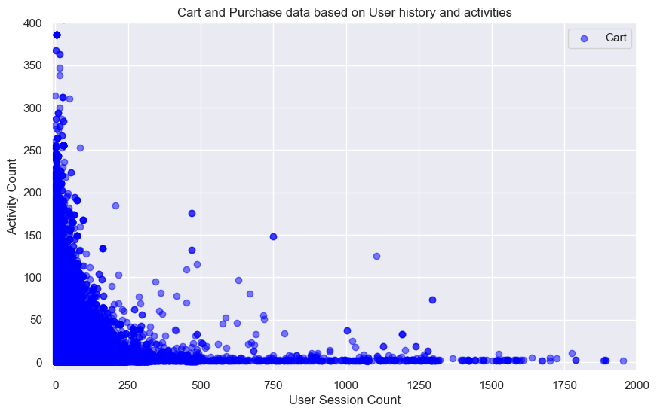
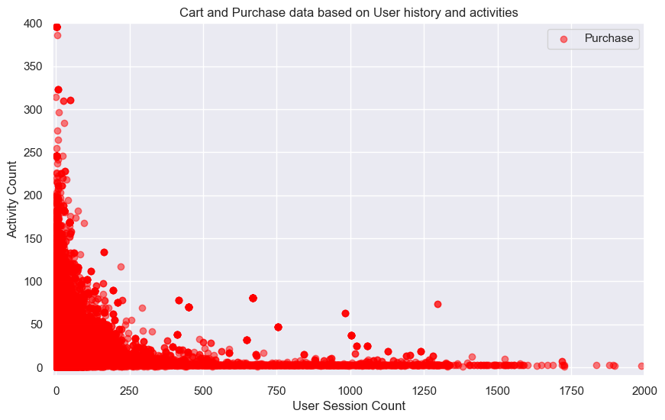
Good Predictors
Session Activities and User's History
User session count – POSITIVE correlation
Signifying the more familiar a user is with the site , the more probable for them to purchase / add to cart
Activity Count – NEGATIVE correlation
The more interactions they have with the site , the LESS probable for them to purchase / add to cart

Slide 16
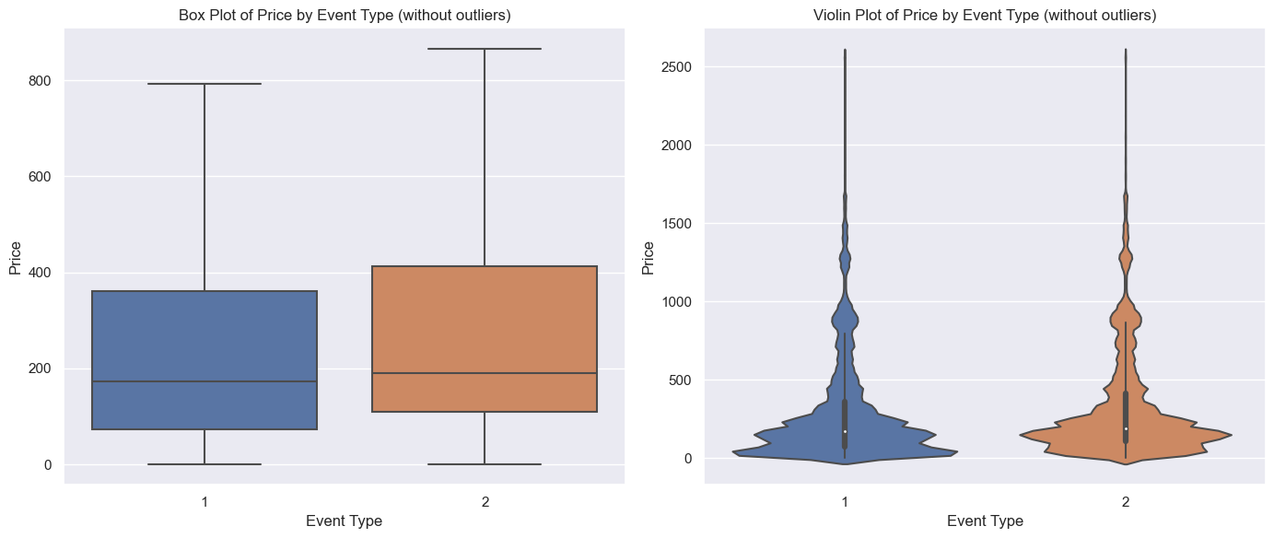
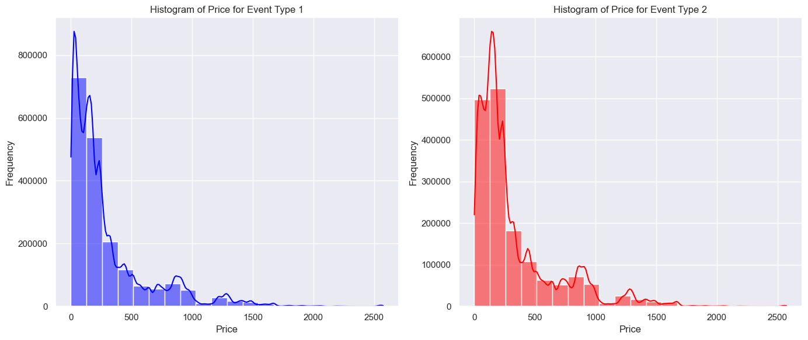
Good Predictors
Price
Slightly higher price will be more likely to be purchased than a lower price as shown in both figure , where event type 2 is purchase
Thus , showing that price does impact whether a user buys the product

Slide 17
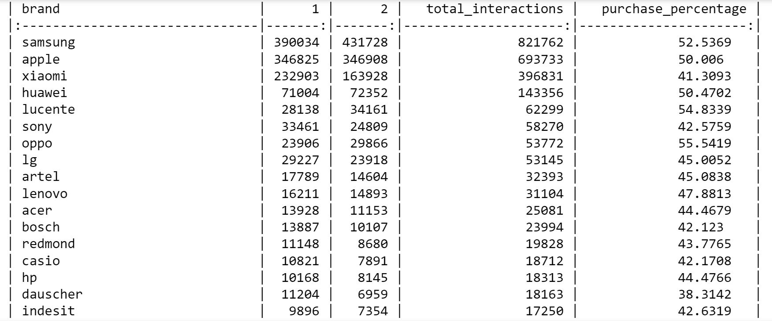
Good Predictors
Brand
We found that the standard deviation purchase percentage of a brand is approximately 21.61 %
Signifying brand does impact whether a user buys a product

Slide 18
03
Classification Models
Notes:
Hi My name is Quan and I will walk you through our Modelling and our insights from this project

Slide 19
ML Techniques Used
 | Classification Tree | Random Forest | XGBoost
Brief Description | Binary decision tree based on 6 predictors | Parallel set of trees with 2 predictors each | Sequential set of trees, each assign a weight to the last.
Why | Basis of Classification | Reduce Variance and avoid overfitting | Reduce error (biases) from the weaker predictors
Max Accuracy | 62.46% | 63.04% | 63.70%
Speed | Fast | Very Slow | Fast
Notes:
We emply 3

Slide 20
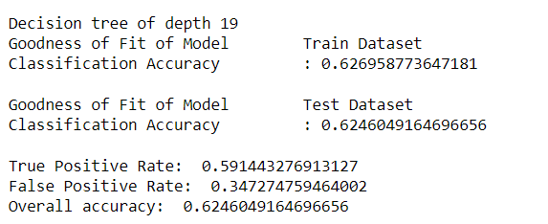
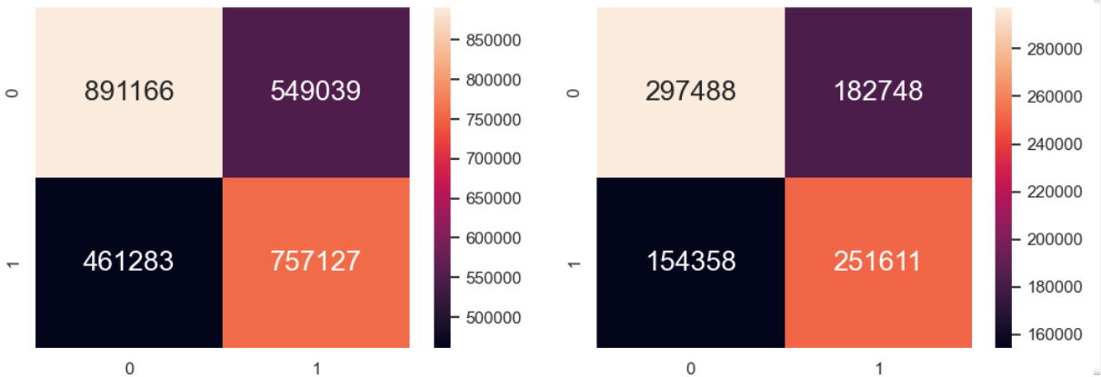
Classification Tree
Confusion Matrix
Train data
Test data

Slide 21
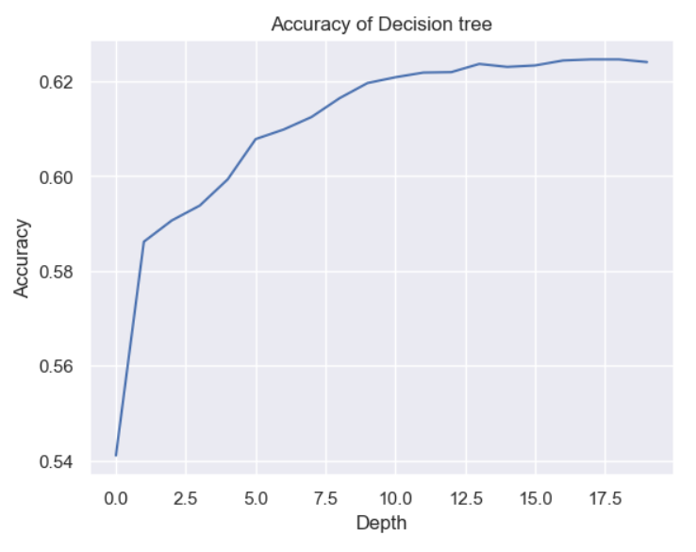
Classification Tree: Optimization
After conduct 20 classification of max depth from 1 -20, we are able to observe that:
Accuracy increases at a decreasing rate, reaching a maximum of 62.46%.

Slide 22
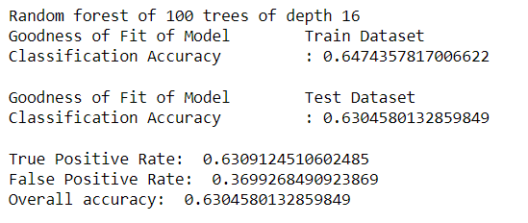
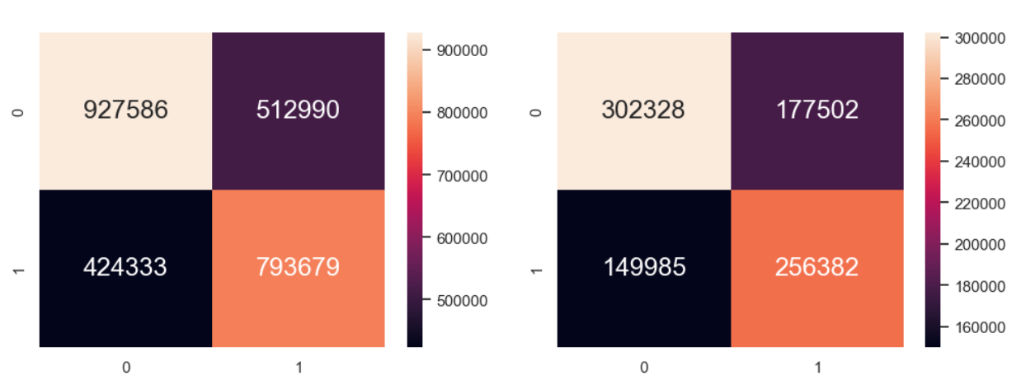
Random Forest
Confusion Matrix
Train data
Test data

Slide 23
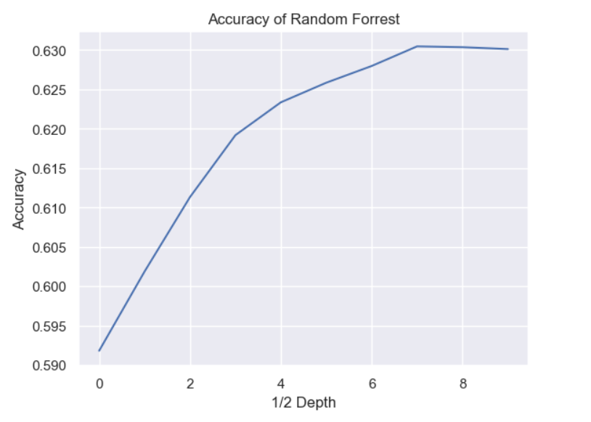
Random Forest: Optimization
After training 10 random forest classification model of max depth from 2-20, we are able to observe that:
Accuracy increases at a decreasing rate, reaching a maximum of 63.04%.

Slide 24
Random Forest: Why little improvement?
Random Forest (a version of Bagging) is aimed to reduce variance and avoid overfitting of model.
However, as we can observe from the classification tree:
There is no sign of overfitting (accuracy of test ≈ accuracy of train)
Since the sample is so large, the variance is likely to be small.

Slide 25
What we tried: Cross-Validation using GridSearch for Random Forest
We tried applying GridSearch to find the optimal number of trees to enhance our accuracy. However, it took too long to compute and we have to abandon the idea.

Slide 26
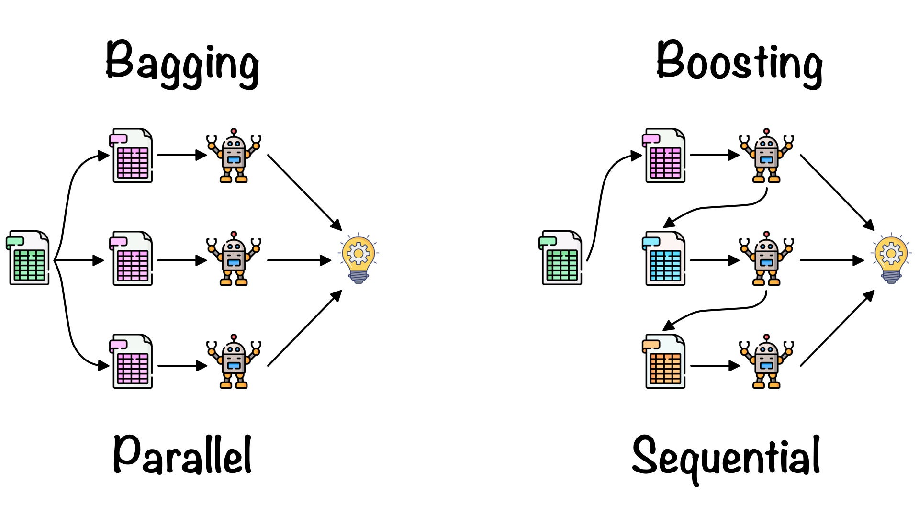
XGBoost Classifier: How it works

Slide 27
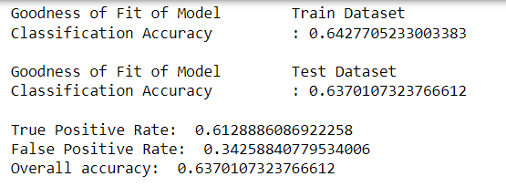
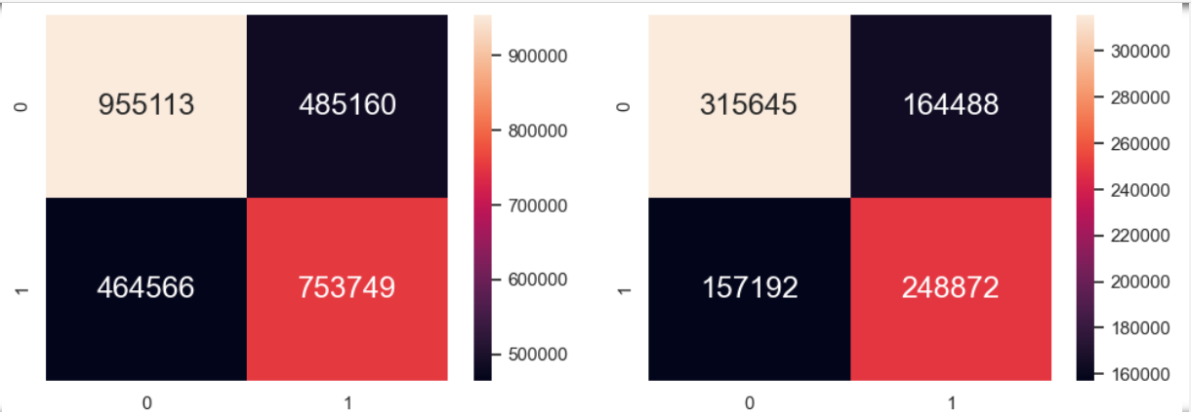
XGBoost Classifier
FINAL ACCURACY: 63.70%
KEY ADVANTAGE: VERY FAST to train
Confusion Matrix
Train data
Test data

Slide 28
04
Conclusion

Slide 29
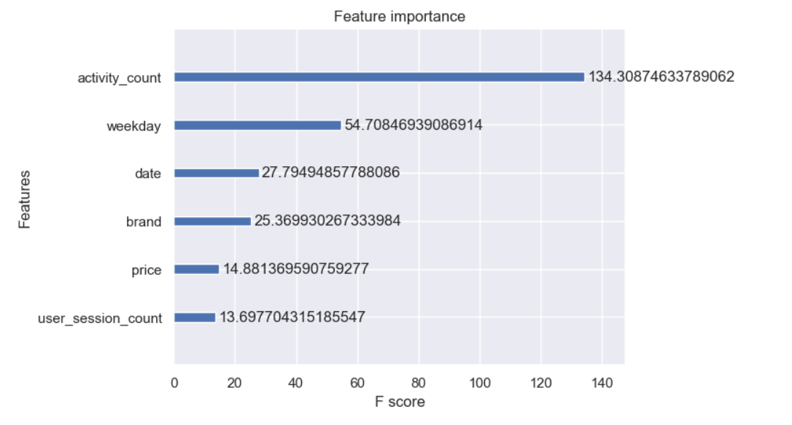
Insights from model
Activity Count is the best predictor for the purchase of a cart item
Weekday is a surprisingly good predictor as well
Brand, Price and User familiarity with the platform does not seem to affect the purchase of a cart item much.

Slide 30
Outcome of our project
It is best for online shopping platform to attract customers with many items and suggest similar products that they have view as this can increase activity count and improve sale
It is important to consider fringe data like Weekday that can give us surprising insights into our customer base or how we run our platform
XGBoost is an efficient model to employ for tabular data to generate highly accurate model when dealing with large volume of data like in the case of online shopping platforms

Slide 31
Limitation and Future Direction
Perform Hyperparameters Tuning for XGBoost using cross-validation
Scale the project size using Dask libraries
Model for view-to-cart process as this is the more practical model that can inform us on how to convert by-passer to customers. 94% of all activities on the platform is view. If we manage to covert more users to put items into cart, we can increase the sale tremendously

Slide 32
Limitation and Future Direction
Perform Hyperparameters Tuning for XGBoost using cross-validation
Scale the project size using Dask libraries
Model for view-to-cart process as this is the more practical model that can inform us on how to convert by-passer to customers. 94% of all activities on the platform is view. If we manage to covert more users to put items into cart, we can increase the sale tremendously

Slide 33
What have we learned
Managing memory: Dealing with large data requires strategic use of memory to not risk stackoverflow
Use XGBoost to build a classification model (and machine learning model in general)
Optimize machine learning model through tuning hyperparameters (e.g. using GridSearch, cross-validation)
What have we hope to learn
Use Dask to scale up our project
More indepth about XGBoost and other Boosting models.

Slide 34
Thank you!

